Slide 1
Combining Datasets
Notes:
In this video, we’ll learn how we can use multiple datasets in our data analysis.

Slide 2




Combining Datasets
Notes:
Combining datasets can increase the quality of the study since it is not done in isolation, but rather different datasets are used to compare and ensure consistent data. Combining datasets can be pretty tricky, however. Pandas has a few functions that can join or merge datasets in different ways.

Slide 3
Concatenating Datasets
Notes:
One way we can combine datasets is to concatenate them. This is similar to when we concatenate strings - we simply add on and attach information. We can concatenate two different data frames by adding the new set as extra columns...

Slide 4
Combining Datasets
Notes:
Like this...or we can attach the data as extra rows...

Slide 5
Combining Datasets
Notes:
As shown here. We’ll look more into this in the next live code video. Concatenating datasets might work if the data in both tables were completely separate entries of data. But what happens if some of the data exists in each data set. How can we merge the data together?

Slide 6

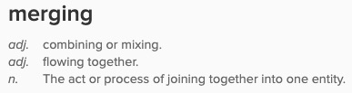
Joining/Merging Datasets
Source: “Wordnik.” Wordnik.com, www.wordnik.com/.
Notes:
Let’s take a look at the difference between concatenation and merging. When you concatenate two data frames, you are just linking them or adding them into a chained data frame. Merging is different. When you merge two data frames you join the data together based on a common column. There are a few different ways to merge data. There are functions that help a lot, but the data scientist is still the one who has to decide which type of merge is the best to use.

Slide 7
Joining/Merging Datasets
pd.merge(df1, df2, on="column", how="method")
Notes:
This is the function to use when merging data.

Slide 8
Joining/Merging Datasets
pd.merge(df1, df2, on="column", how="method")
Notes:
First, we’ll include the two datasets that we are going to merge.

Slide 9
Joining/Merging Datasets
pd.merge(df1, df2, on="column", how="method")
Notes:
Then, we have to choose a column or a list of columns to have the function search though in order to connect the two.

Slide 10
Joining/Merging Datasets
pd.merge(df1, df2, on="column", how="method")
Notes:
Then, we add the type of join that we’d like to use. Let’s take a look at the different types.

Slide 11
Joining/Merging Datasets
Student_ID | Name | Hobby
1 | Cassy | Climbing
2 | Sarah | Reading
3 | Pascal | Drawing
Student_ID | Age | City
1 | 15 | Richmond
2 | 26 | Portland
4 | 32 | Denver
df1
df2
Notes:
Here, we have two datasets.

Slide 12
Primary Key
Student_ID | Name | Hobby
1 | Cassy | Climbing
2 | Sarah | Reading
3 | Pascal | Drawing
Student_ID | Age | City
1 | 15 | Richmond
2 | 26 | Portland
4 | 32 | Denver
df1
df2
Primary Key: The Student_ID column is unique in that there can only be one row per student ID.
Notes:
If we take a look at the primary key, which is the Student_ID in this case, we can see that there are some duplicates. This means that Cassy, who has the primary key of 1 has a hobby of climbing as shown in the first dataset but also we know that she is 15 and is from Richmond as shown in the second dataset. We’d like to merge this information into one dataset. Let’s see how to best do that.

Slide 13
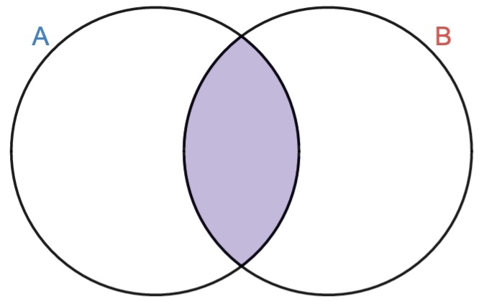
Inner Join
Inner Join: Searches through the specific column and keeps ONLY the rows that have a matching value.
Notes:
There are four types of joins that we can choose from. An inner join will search through the column that we specify and only keep the rows that have a value that exists in both dataframes.

Slide 14
Inner Join
Student_ID | Name | Hobby
1 | Cassy | Climbing
2 | Sarah | Reading
3 | Pascal | Drawing
Student_ID | Age | City
1 | 15 | Richmond
2 | 26 | Portland
4 | 32 | Denver
df1
df2
Notes:
So, if we look here, the inner join will only keep rows with the primary key of 1 and 2. 3 and 4 will not be included in the merged dataset.

Slide 15
Inner Join
Student_ID | Name | Hobby | Age | City
1 | Cassy | Climbing | 15 | Richmond
2 | Sarah | Reading | 26 | Portland
pd.merge(df1, df2, on="Student_ID", how="inner")
Only rows where the Student_ID is in BOTH tables are displayed.
Notes:
Now, all of Cassy’s information is included in one dataset and one row. Not sure if this would be the best option for our example, though. We lose information about the other two students using this join!

Slide 16
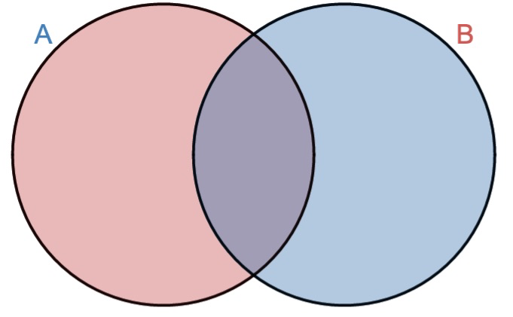
Outer Join
Outer Join: Searches through the specific column and keeps ALL of the rows in each data frame while merging matching rows.
Notes:
An outer join keeps everything! It will merge the rows that exist in both data frames, but also includes the rows that don’t have matching values as well.

Slide 17
Outer Join
Student_ID | Name | Hobby
1 | Cassy | Climbing
2 | Sarah | Reading
3 | Pascal | Drawing
Student_ID | Age | City
1 | 15 | Richmond
2 | 26 | Portland
4 | 32 | Denver
df1
df2
Notes:
This time it’ll merge keys 1 and 2 and then also keep keys 3 and 4.

Slide 18
Outer Join
Student_ID | Name | Hobby | Age | City
1 | Cassy | Climbing | 15 | Richmond
2 | Sarah | Reading | 26 | Portland
3 | Pascal | Drawing | NaN | NaN
4 | NaN | NaN | 32 | Denver
pd.merge(df1, df2, on="Student_ID", how="outer")
All rows from BOTH tables. Data merges for rows that have Student_ID in BOTH tables
Notes:
Ok, this is good! You might notice that NaN is used when a value is missing. This is still good information to know when accessing the completeness of the dataset.

Slide 19
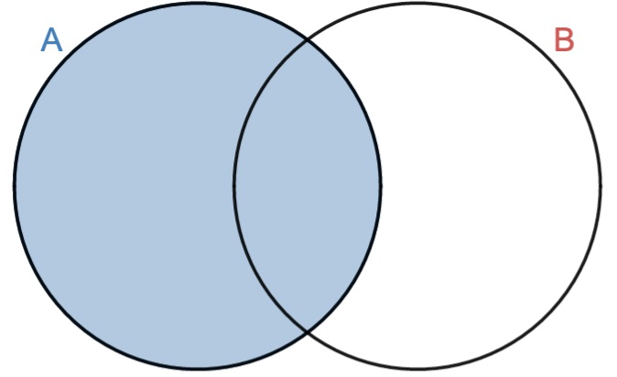
Left Join
Left Join: Keeps all of the left data frame, searches through the specific column and adds in the data that have matching values in the right data frame.
Notes:
Another join that we could use is a left join. A left join will keep the entire left dataframe and then add in and merge only the rows that have a matching value from the second data frame.

Slide 20
Left Join
Student_ID | Name | Hobby
1 | Cassy | Climbing
2 | Sarah | Reading
3 | Pascal | Drawing
Student_ID | Age | City
1 | 15 | Richmond
2 | 26 | Portland
4 | 32 | Denver
df1
df2
Notes:
In this case, it will keep everything from the first data frame and then only add on matching information in the second. This might be helpful if we are only concerned with entries that include the student’s name.

Slide 21
Left Join
Student_ID | Name | Hobby | Age | City
1 | Cassy | Climbing | 15 | Richmond
2 | Sarah | Reading | 26 | Portland
3 | Pascal | Drawing | NaN | NaN
pd.merge(df1, df2, on="Student_ID", how="outer")
All rows from BOTH tables. Data merges for rows that have Student_ID in BOTH tables
Notes:
So, in this case we lose the entry that had the key of 4. We still have a few missing values as well. But, the missing values are not names.

Slide 22
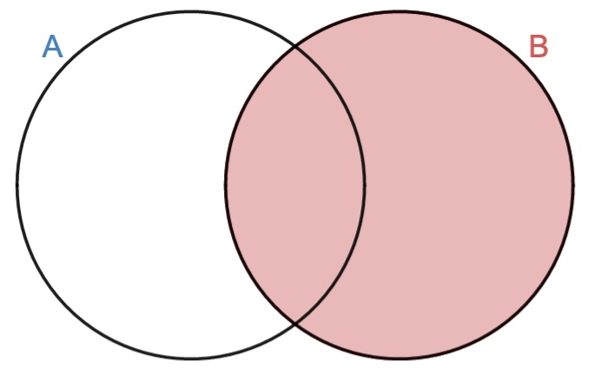
Right Join
Right Join: Keeps all of the right data frame, searches through the specific column and adds in the data that have matching values in the left data frame.
Notes:
We can also complete this in the opposite way. A right join will keep the entire right dataframe and then add in and merge only the rows that have a matching value from the first data frame. Merging data can be confusing without an example to see how it works exactly. We will go over all of these join methods in the next live code video.

Slide 23
Right Join
Student_ID | Name | Hobby
1 | Cassy | Climbing
2 | Sarah | Reading
3 | Pascal | Drawing
Student_ID | Age | City
1 | 15 | Richmond
2 | 26 | Portland
4 | 32 | Denver
df1
df2
Notes:
Here, it will keep everything in the second dataframe and add on only matching keys from the first. Maybe including an age is most important.

Slide 24
Right Join
Student_ID | Name | Hobby | Age | City
1 | Cassy | Climbing | 15 | Richmond
2 | Sarah | Reading | 26 | Portland
4 | NaN | NaN | 32 | Denver
pd.merge(df1, df2, on="Student_ID", how="outer")
All rows from BOTH tables. Data merges for rows that have Student_ID in BOTH tables
Notes:
So, we lose key 3, but we are not missing any ages.

Slide 25
Combining Datasets
Function | Use
df.rename(columns={"old_column": "new_column"}) | renames columns in a dataframe
pd.concat([df, df2]) | adds second data frame to the first as new rows
pd.concat([df, df2]), axis=1) | adds second data frame to the first as new columns
pd.merge(df1, df2, on="column", how="method")) | joins data frames on a specific column value
Notes:
Here is a summary of the functions that we can use to combine datasets. We’ll first want to rename any columns that hold the same type of information and then we can concatenate or merge the data. We’ll take a closer look at combining datasets in the next live code video.

Slide 26
Lesson Vocabulary
Term | Definition
inner join | Searches through the specific column and keeps ONLY the rows that have a matching value.
outer join | Searches through the specific column and keeps ALL of the rows in each data frame while merging matching rows.
left join | Keeps all of the left data frame, searches through the specific column and adds in the data that have matching values in the right data frame.
right join | Keeps all of the right data frame, searches through the specific column and adds in the data that have matching values in the left data frame.

